Slide 1
Eastmont Food Service Meal Pick Up Schedule Beginning Tuesday, September 8th
Lee Elementary - 11:00am - 12:30pm
Eastmont Jr High School – 10:45am - 12:45pm
OR Monday - Thursday 4:30pm - 6:00pm
Clovis - 11:00am – 12:30 pm
Rock Island Elementary - 11:00am - 12:30pm
Children who live in proximity of school meal sites are expected to pick up meals at these locations Monday-Friday.
Meals are available free of charge for all children 18 years of age and younger.
Children do not need to be enrolled at Eastmont School District.
One meal per child. Parents may pick up for children not present.
For questions concerning Food Service, please call 884-3026
This institution is an
equal opportunity provider.

Slide 2
Updated! Information about Meal Pick-up 9/1/2020
All meals are free of charge for any child aged 18 years and younger. Children do not need to be enrolled at Eastmont School District.
Students do not need to be present. Parents or guardians can pick up meals.
Meals will only be distributed on school days.
Eastmont School District will transition back to normal operation as soon as it is safe and approved by local health officials.
If your income has changed, this may be a good time to apply for free or reduced price meal benefits for the 2020-2021 school year. Apply online at: www.myschoolapps.com or www.eastmont206.org/departments/food-services
None of the pick up times work for my family. Please call the Food Service Office at 884-3026 or email Food.Service.Office@eastmont206.org You will be contacted to make alternative arrangements.
Si usted necesita asistencia en español visite la pagina web www.eastmont206.org.
This institution is an equal opportunity provider.

Slide 3
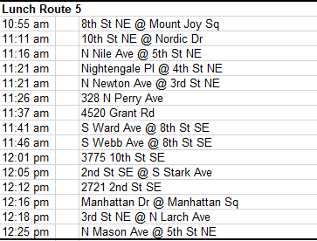
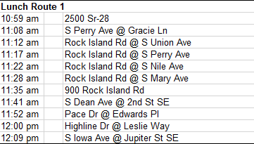
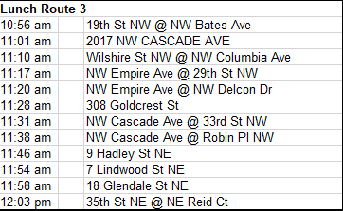
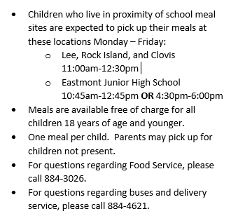
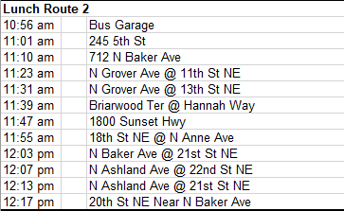
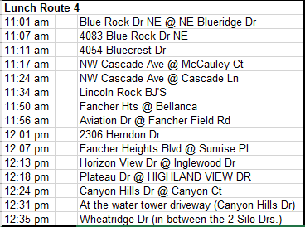
Eastmont Meal Delivery Routes Effective 9/8/2020

